Slide 1
your best choice

Slide 2
Part one
The new technology

Slide 3
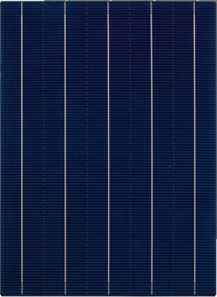
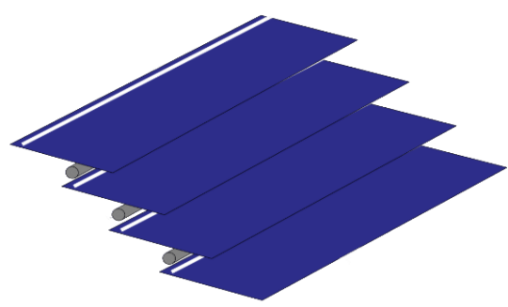
Core Tech.- Shingling
Shingling Technology
Slicing solar cells into small pieces by laser cutting;
Overlaping and stringing sliced cells by automatic machines;
Laminating to modules.
Cell Slicing
Stringing
Lamination
Exclusive Customized
Customized according to requirements
Flexible & Dynamic
Different materials according to applied enviroments
Hi-Effinciency
Higher power output
Better performance
Exquisite Appearance
Better appearance, better integrated into enviroments

Slide 4
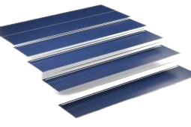
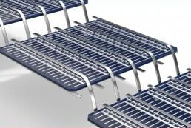
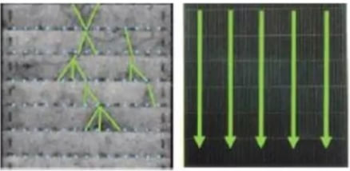
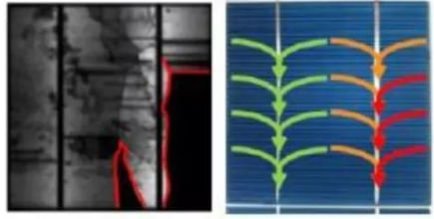
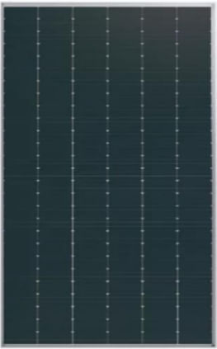
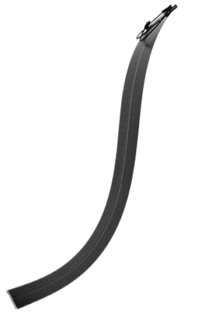
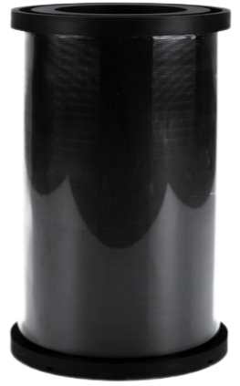
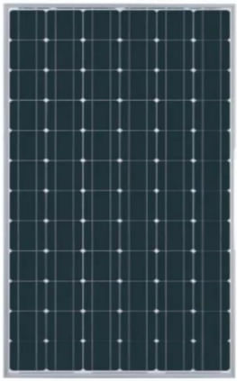
Core Tech.- Shingling
Shingling
Traditional
No welding ribbon, increase the generating surface
Welding ribbon, decrease the generating surface, metal reflection
Enlarge the conduct surface, minimize the risk of micro-crack
Ribbon connection, wafer damage risk, increase the micro-crack risk
Highly customized, flexibile, apply to many scenarios
Rigid frame, no flexibility, low customizable

Slide 5
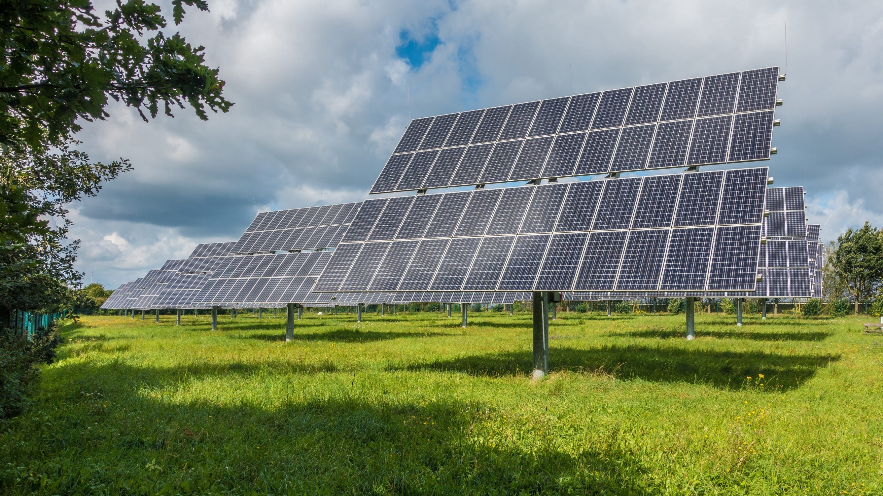
Leading Production Ability
Lightweight Tech.
Flexbility Tech.
Shingling Tech.
Key Tech.
Self developed materials
Patented Structures
Test-passed materials and structures
Self developed main materials: front and back sheets, fiber glass layer, etc.
Self developed structure and welding process. Leading technologies in materials and process precision.
Products Advantages
3.4kg/㎡，1/4 weight of traditional panels
248degree bendable
1.5% higher eff. than normal MBB panels
Appearance：Aesthetic，Dazzling Light Resisstance
Easy Installation：Easy to handle, transport and install; cost saving
Reliability：Shock Resistance
Hi-Adaptability：Bendable to fit different curve surface.
Multiple Scenarios：Applicable for different installation environments
Dynamic & Stable：Dynamic design according to electric requirements, stable power output
Hi-Customizable：Design according to applied environments, aesthetic appearance
Hi-eff.：Larger working surface, higher output.
Application Advantages
Innovation Driven
42 Patented Tech.
22 Patents for Invention
13 Patents
for Practical New-Type
7 Patents for Design

Slide 6
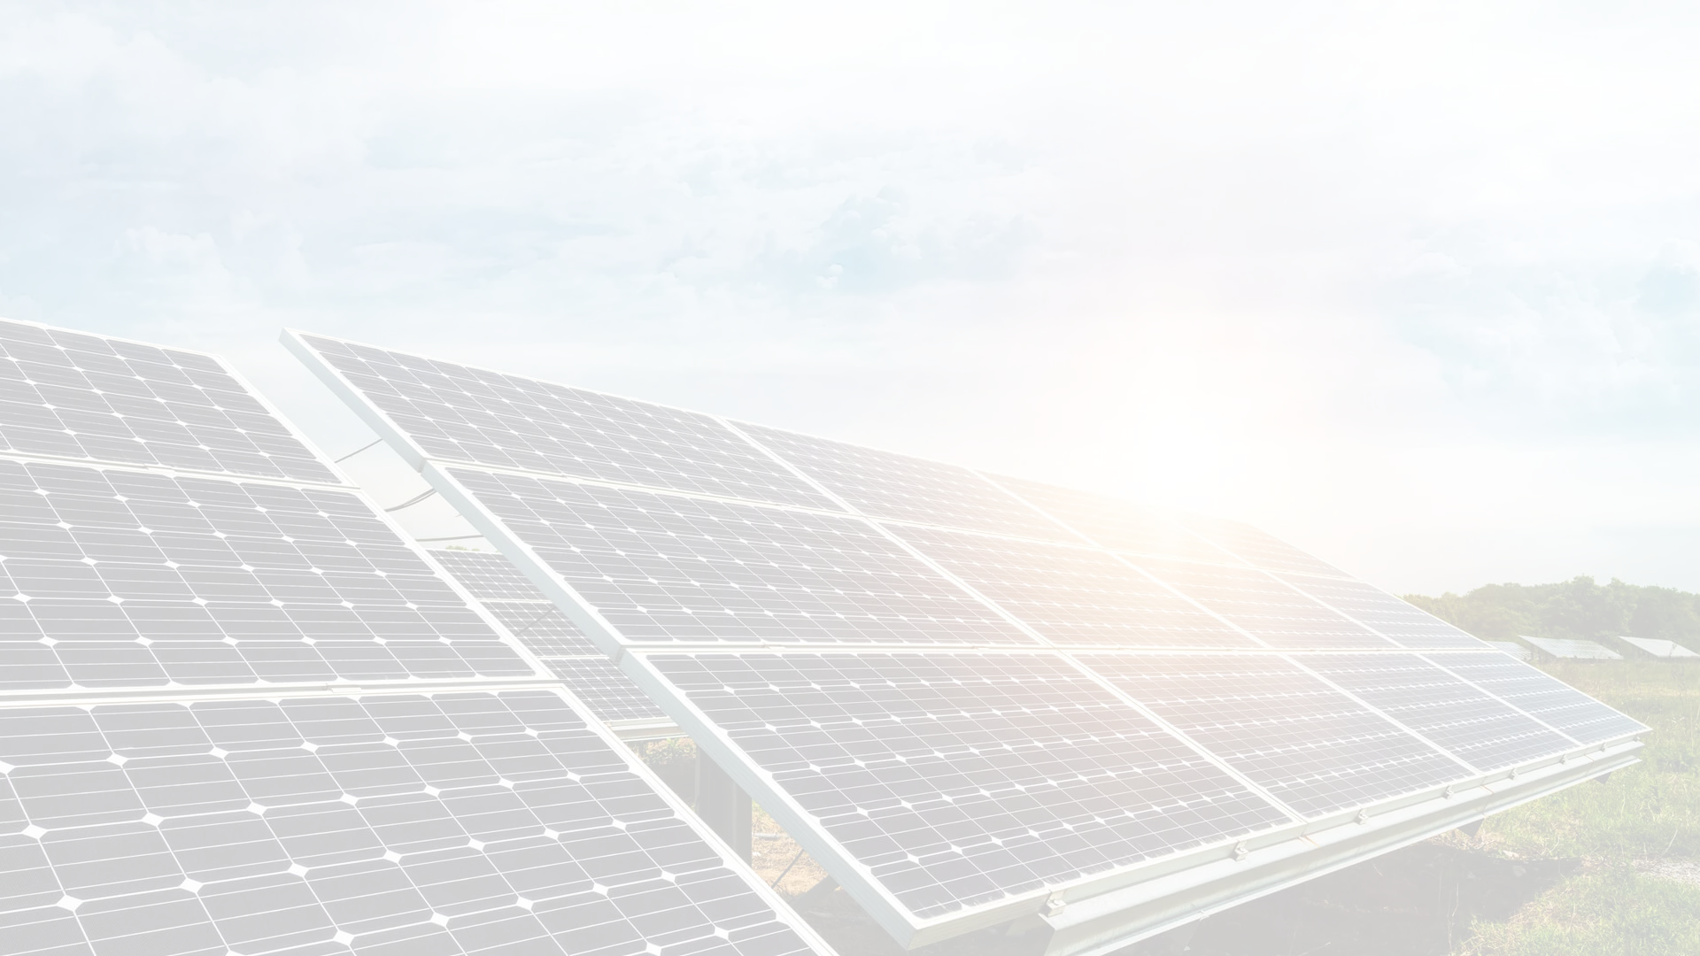
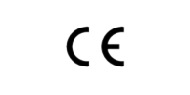
International Certifications

Slide 7
Part two
Innovations and Products

Slide 8
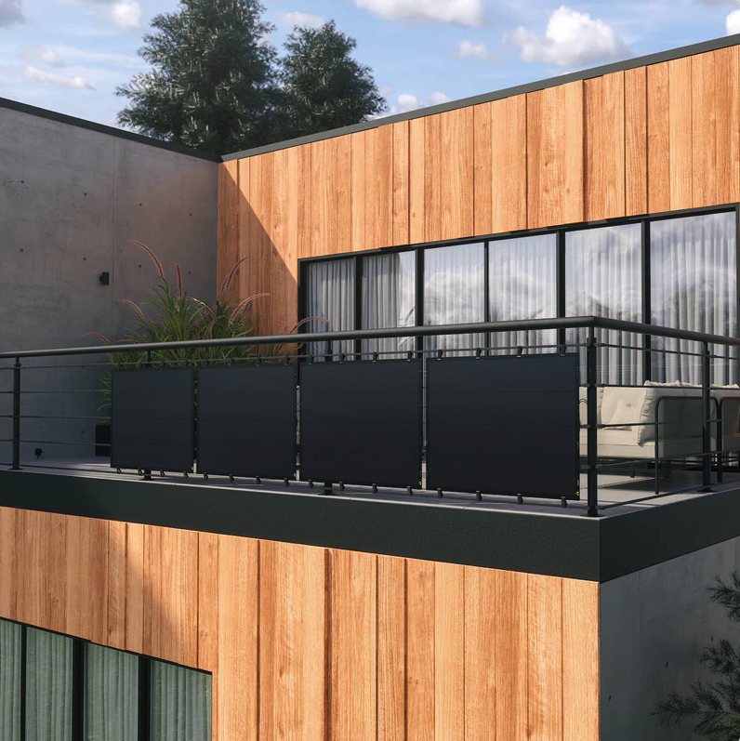
Mini Energy Transfer
MET-1 System
Offer a cost-effective mode of power supply
Experienced R&D and production team
Convenient solar solutions for different
power supply requirements
Eco-friendly materials
Higher power output
Better performance

Slide 9
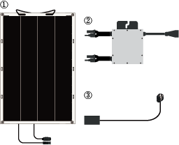
Mini Energy Transfer
MET-1 System
Offer a cost-effective mode of power supply
Fast Installation: Easy for handling
Light Weight: Frameless, Glass free
Multiple Using Scenarios:
As long as there is sunshine
Component
① Flexible Solar Panel*3
② Micro-inverter*1
③ Extension Cable*1

Slide 10
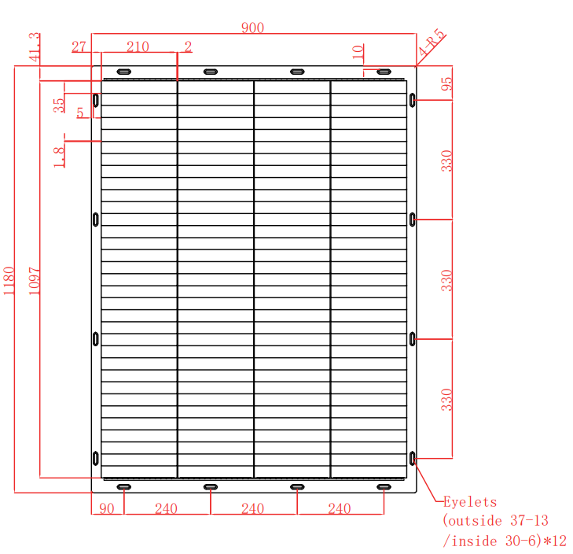
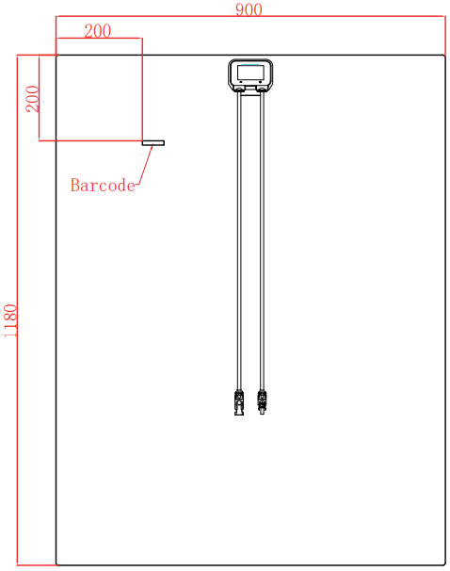
Product display - 205 W Flexible solar Panel

Slide 11
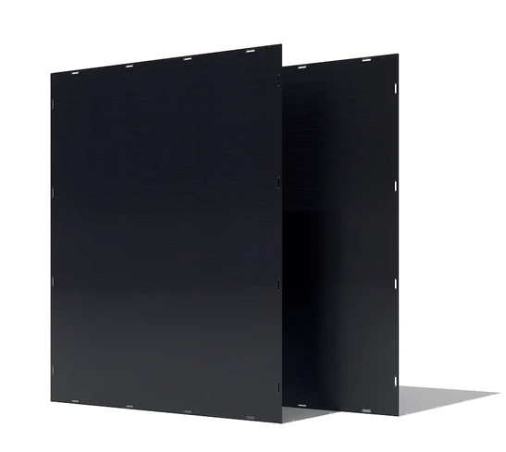
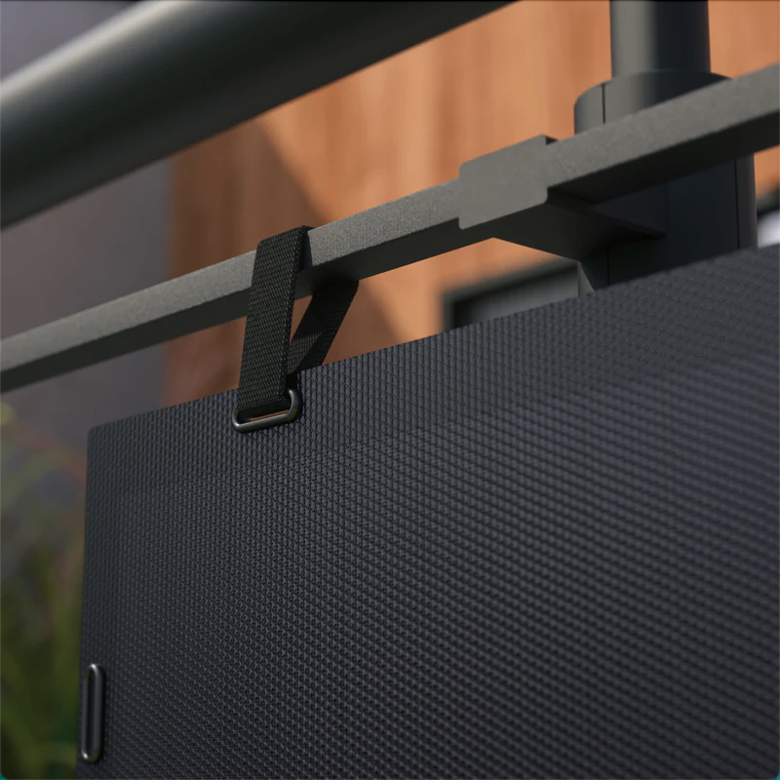
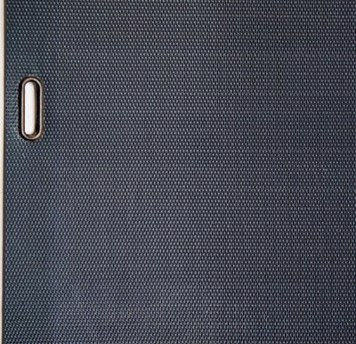
Mini Energy Transfer
MET-1 System
Panel Details

Slide 12
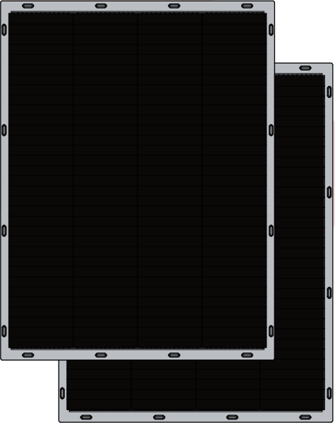
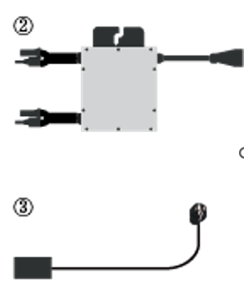
Product display - 205 W Flexible solar Panel
Light + easy = your choice

Slide 13
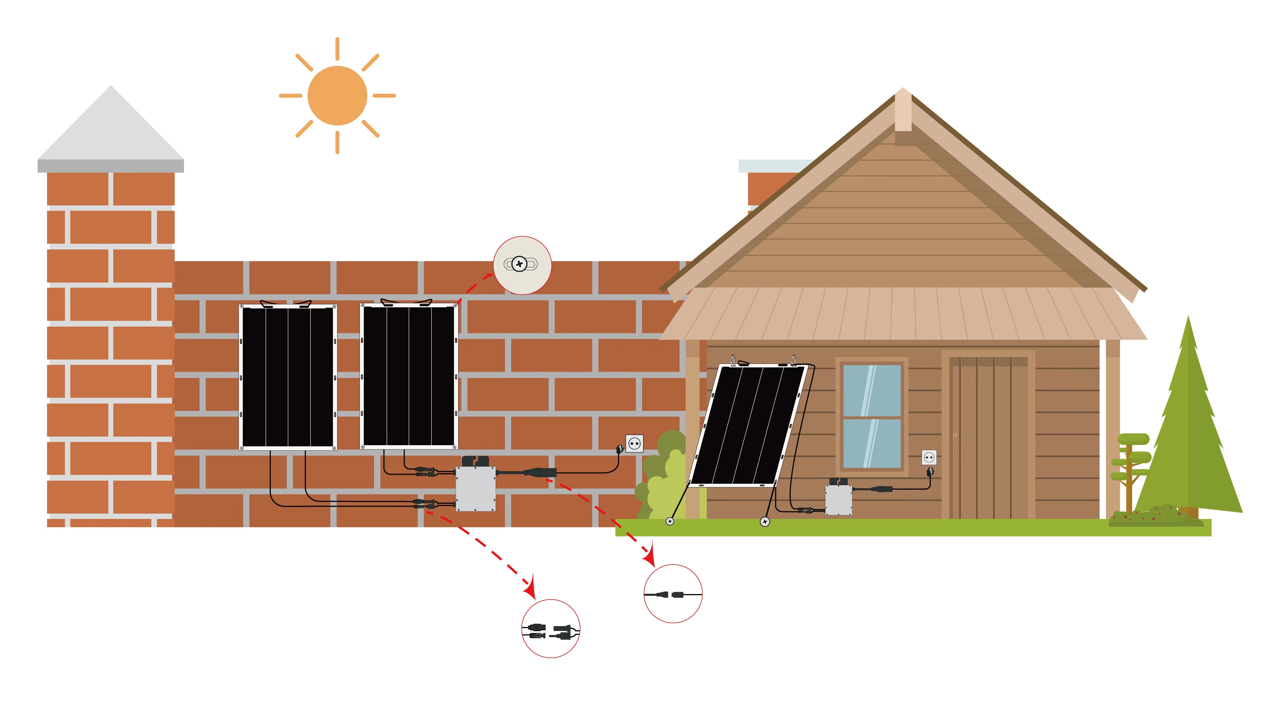
Mini Energy Transfer
Multiple Installation Options

Slide 14
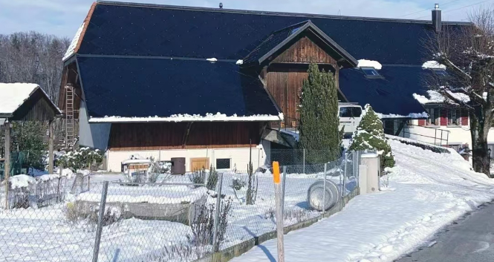
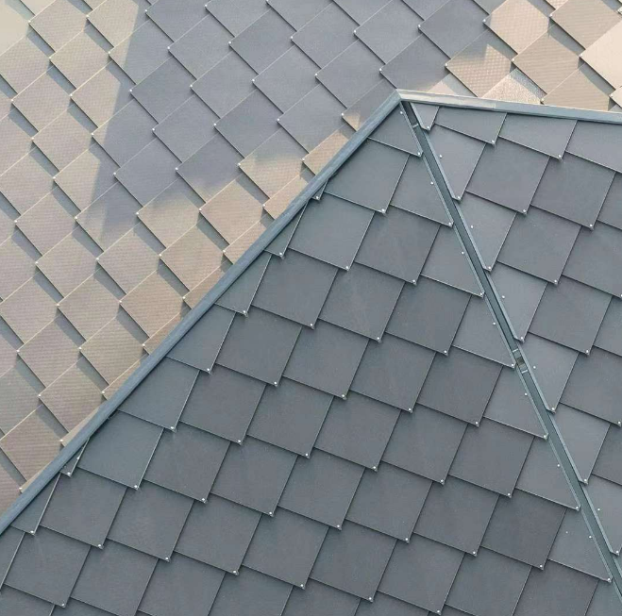
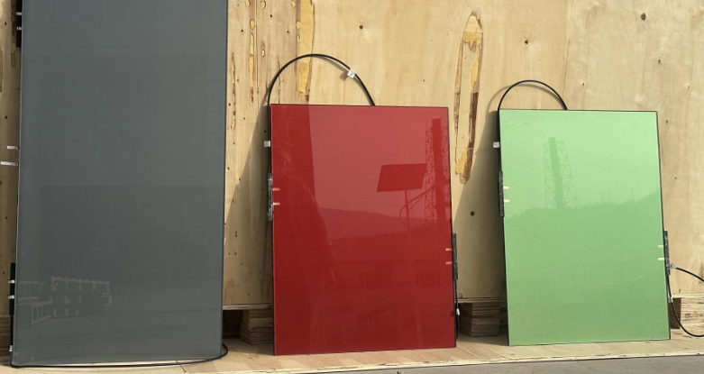
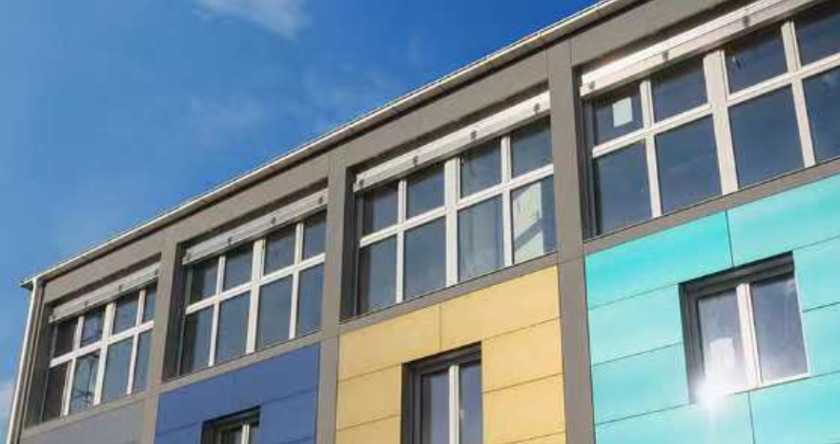
Weitere Elegante Module für Bau

Slide 15
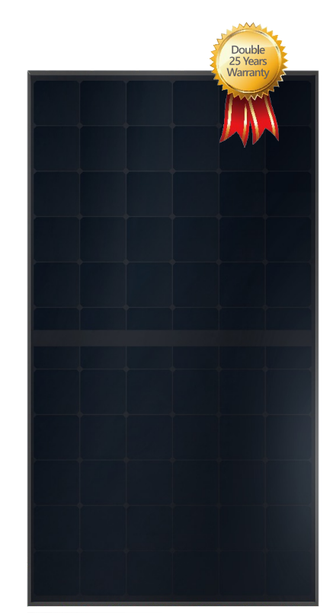
Elegante Module
FEATURES
Up to 21,6% Efficiency
Bigg dimension, More power generation
All black or different colour
IBC-No electrode to block sunlight
N-Type Cell has ZERO LID
Excellent Temperature Coefficient
Anti-PID
Low mismatch loss
Minimal Power degradation(93% of initial after 25 years)
Double 25 years Warranty

Slide 16
Contact Details
Loada-Solar by Quantums GmbH
Otto-Hahn-Str.9, 63225 Langen, Germany
General Manager: Muzi Xu, mx@loada-solar.de, +4917631227947
Director of Sales: Patrick R. Jesser, p.jesser@loada-solar.de, +4917660030917

